Slide 1
CUFFLESS BLOOD PRESSURE ESTIMATION ALGORITHMS USING PPG AND ECG
Kachuee, Mohammad & Kiani, Mohammad Mahdi & Mohammadzade, Hoda & Shabany, Mahdi. (2016). Cuff-Less Blood Pressure Estimation Algorithms for Continuous Health-Care Monitoring. IEEE Transactions on Biomedical Engineering. 64. 1-1. 10.1109/TBME.2016.2580904.
Presented by:
Muhammad Saqlain Aslam
Pratul Ranjan
呂佳奇

Slide 2
Outline
Preprocessing
Feature Extraction
Experiment Setup
Experiment Result

Slide 3
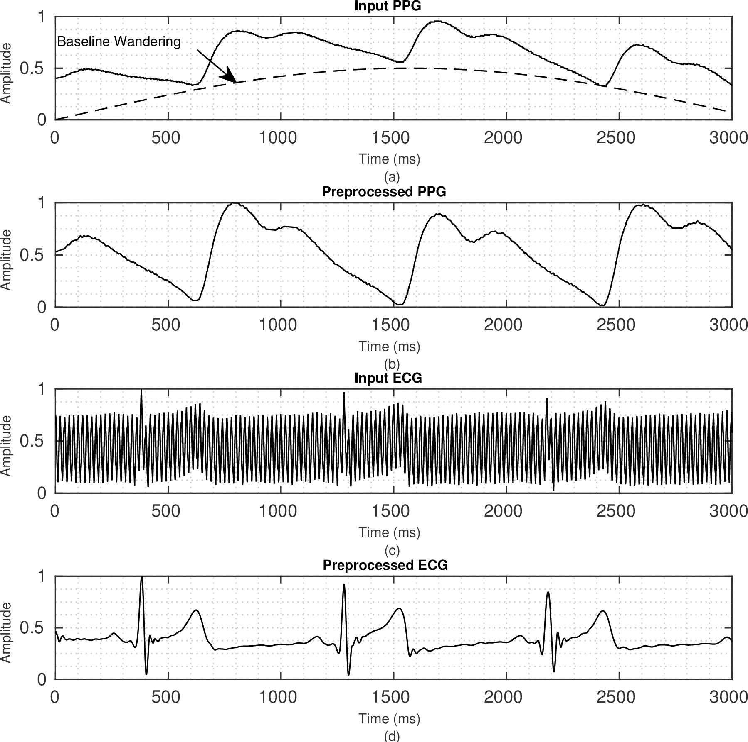
Pre-processing: Example
PPG Preprocessing Example
ECG Preprocessing Example
Notes:
The baseline wandering of the signal, which is considered as the respiration artifact and appears as a low-frequency component in the time domain, and it can deteriorate the accuracy of digitalization due to the saturation of analog circuitry or reduced effective precision of them.
High-frequency and nonstationary noises that are due to muscular activities.

Slide 4
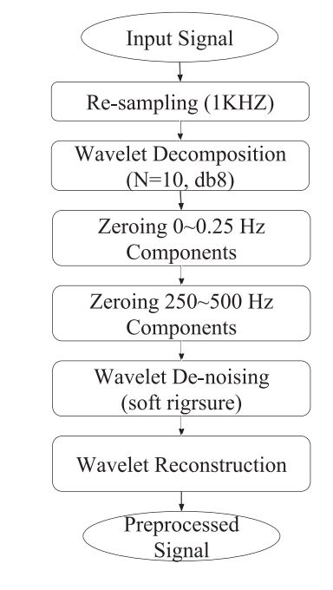
Pre-processing: Pipeline
Baseline wandering
Muscle activity artifact
Fig. Raw signal pre-processing pipeline

Slide 5
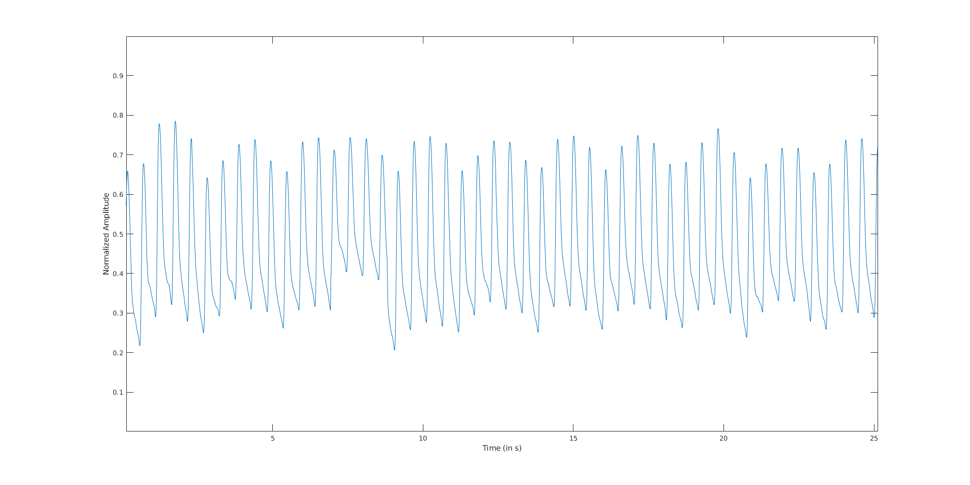
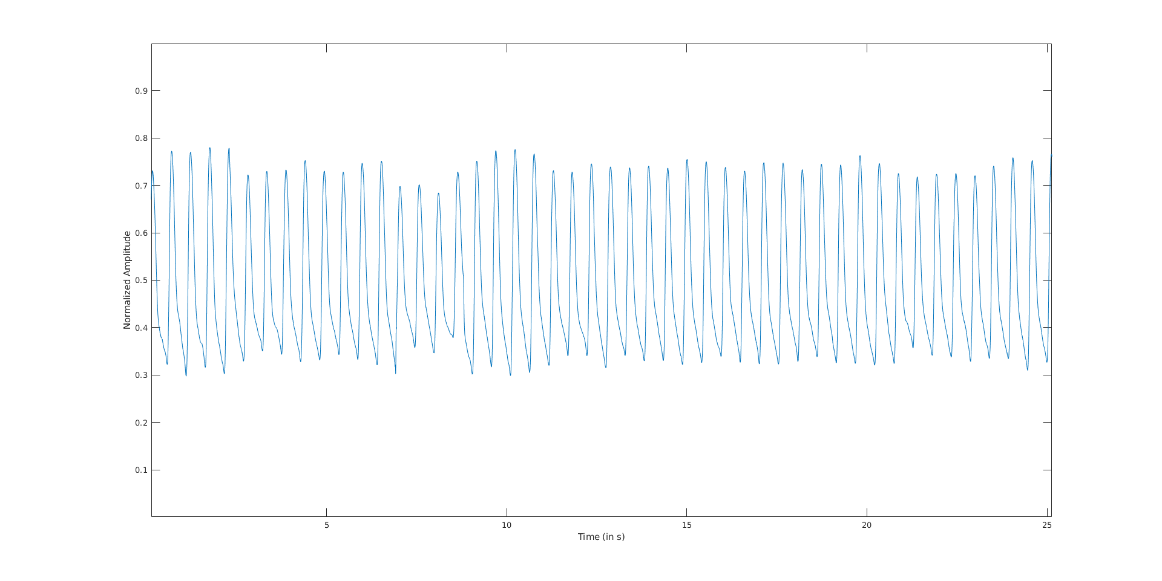
Pre-processing Result
Input PPG
Preprocessed PPG

Slide 6
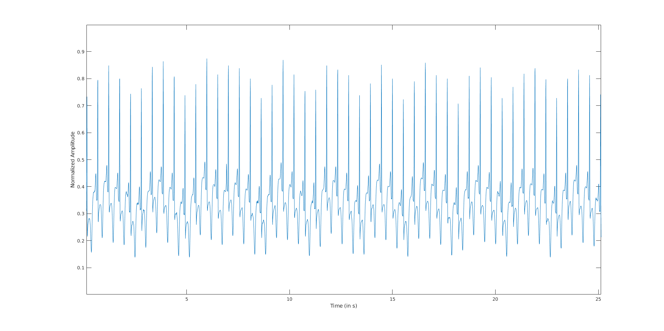
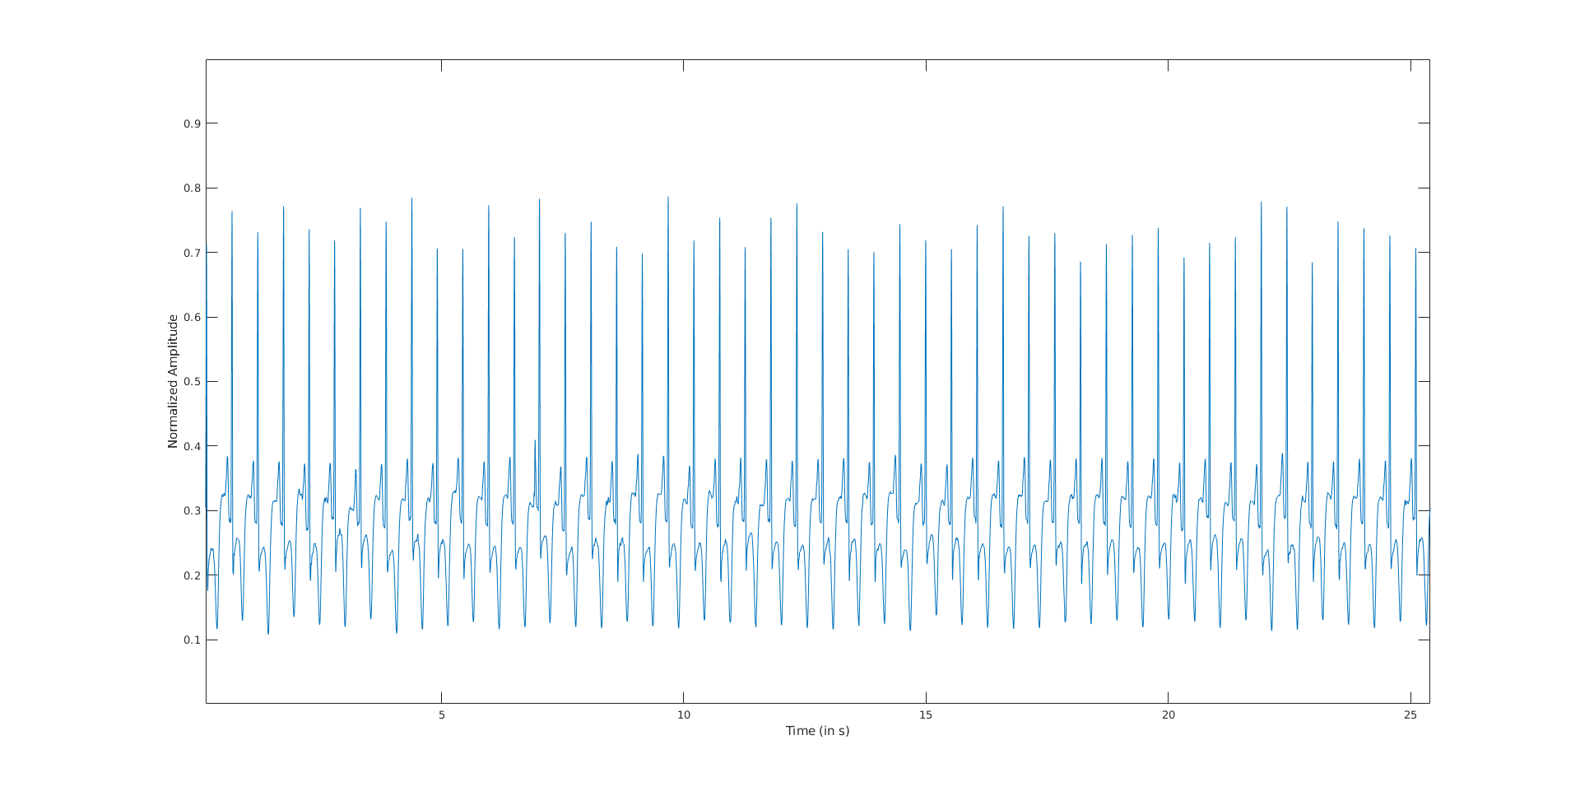
Pre-processing Result
Input ECG
Preprocessed ECG

Slide 7
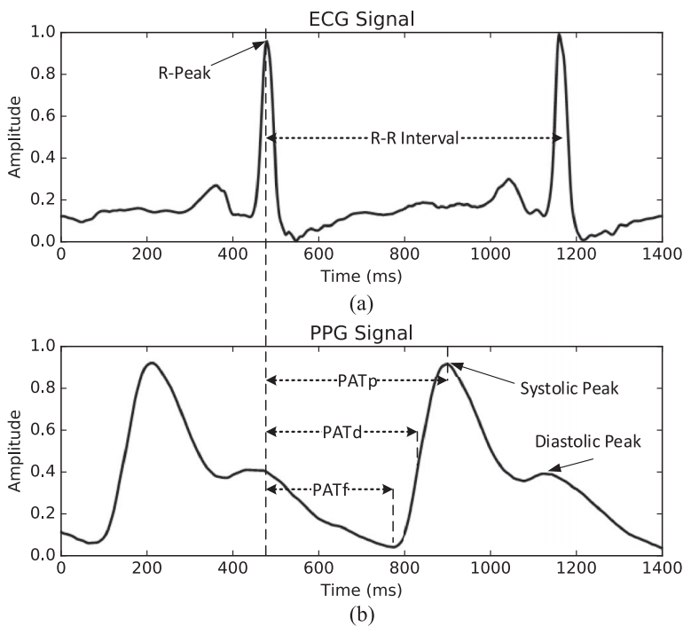
Feature Extraction: Parameter Based
1) PAT features
2) Heart Rate (‫HR)

Slide 8
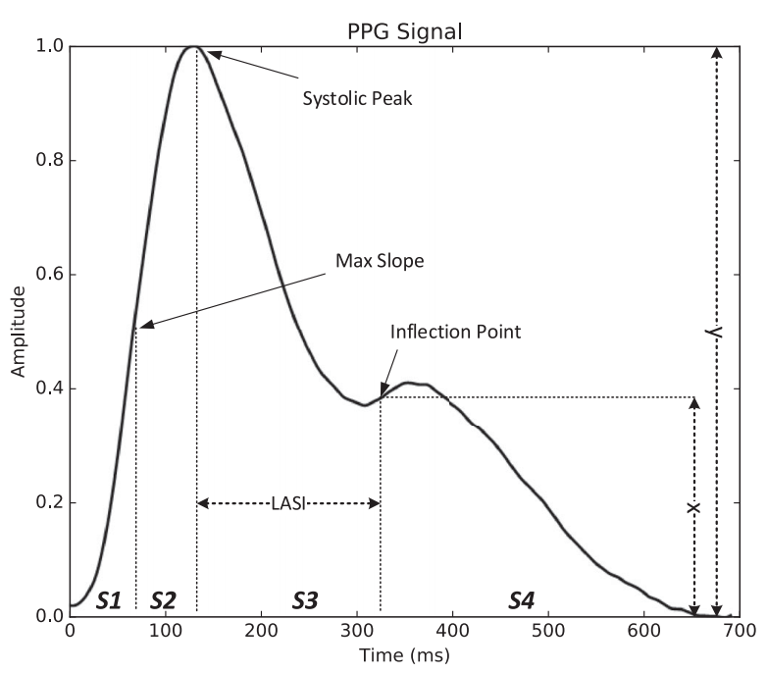
Feature Extraction: Parameter Based
3) Augmentation Index (‫AI)
A measure of wave reflection
AI = x / y
4) Large Artery Stiffness Index (‫LASI)
– Indicator of arterial stiffness
5) Inflection Point Area (‫IPA)
– Area S1, S2, S3 and S4 as shown in figure.

Slide 9
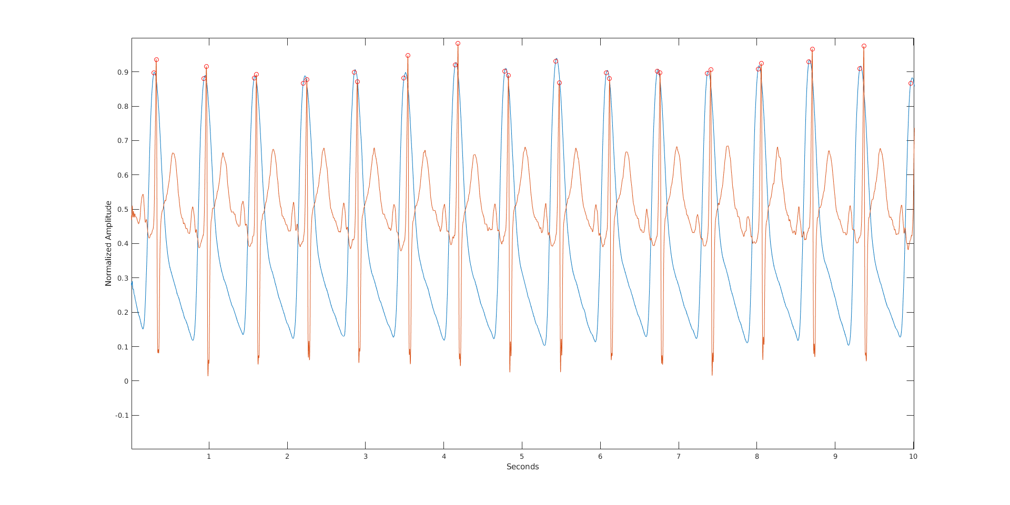
Feature Extraction: Parameter Based
Red Curve: ECG
Blue Curve: PPG
Red Circles: Corresponding Peaks

Slide 10
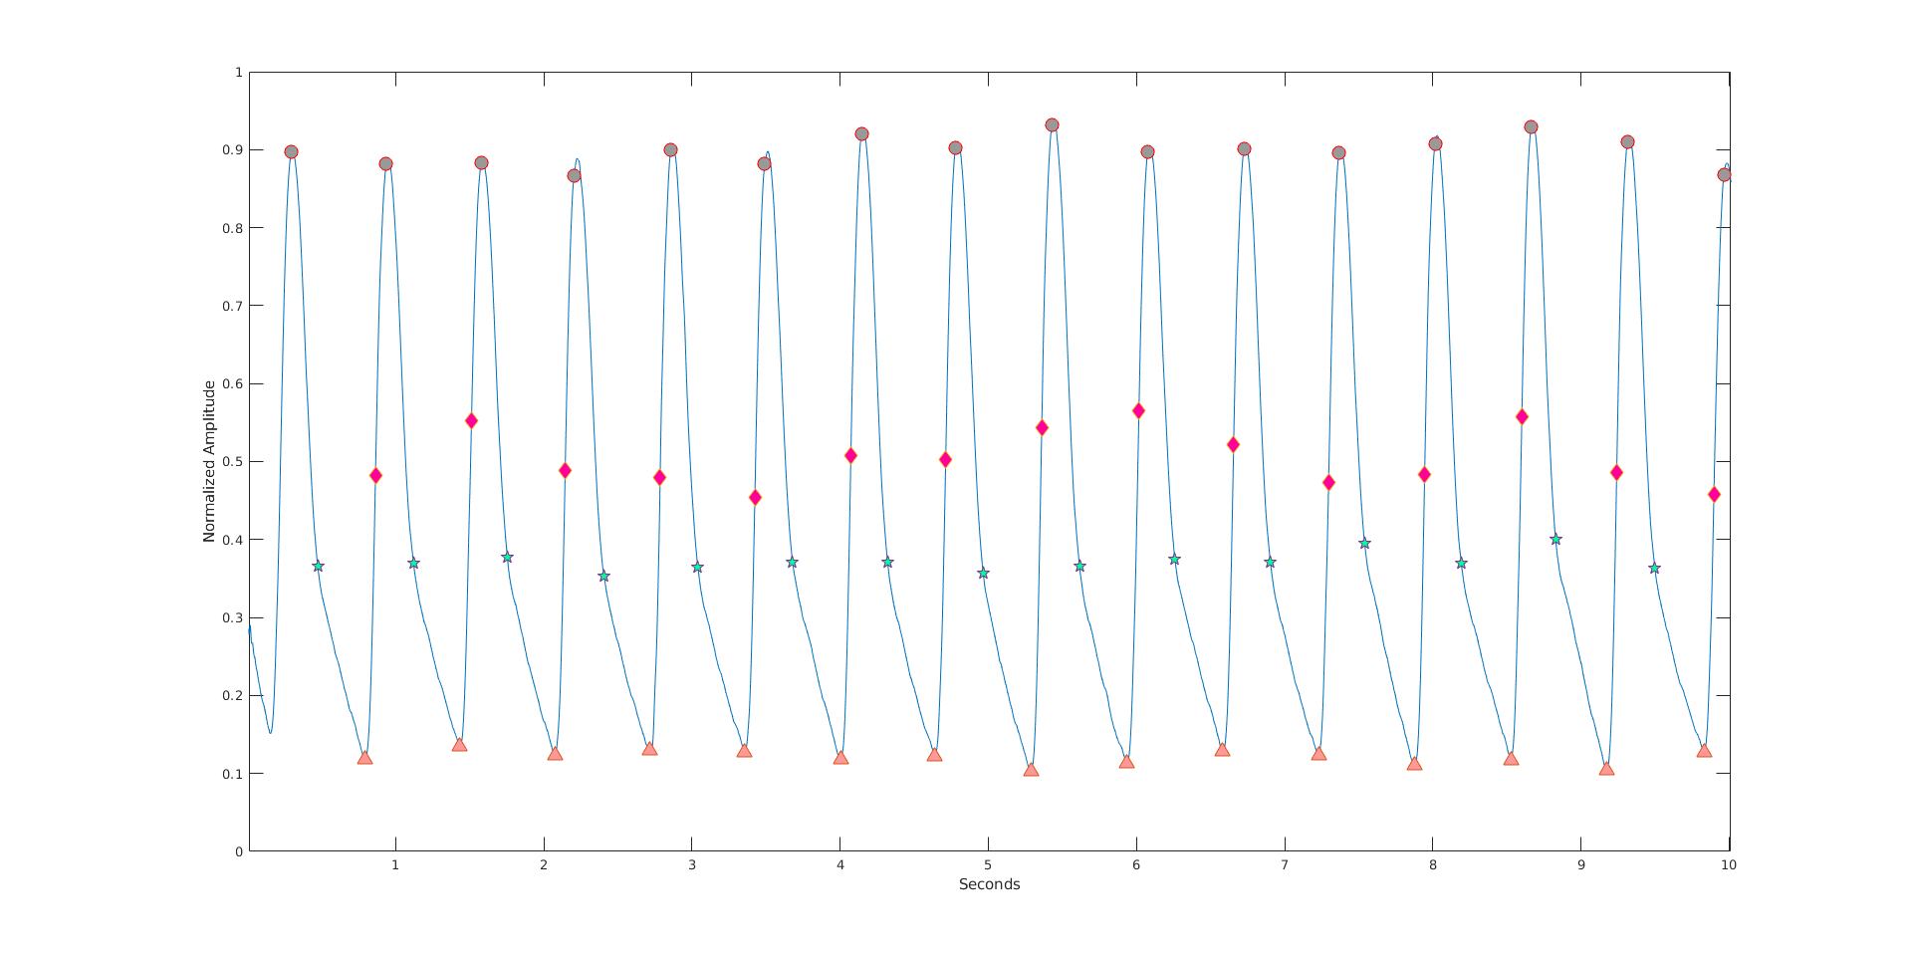
Feature Extraction: Parameter Based
PPG Signal
Circles: Systolic Peaks
Triangles: Diastolic Peaks
Diamonds: Max slope points
Stars: Inflection points

Slide 11
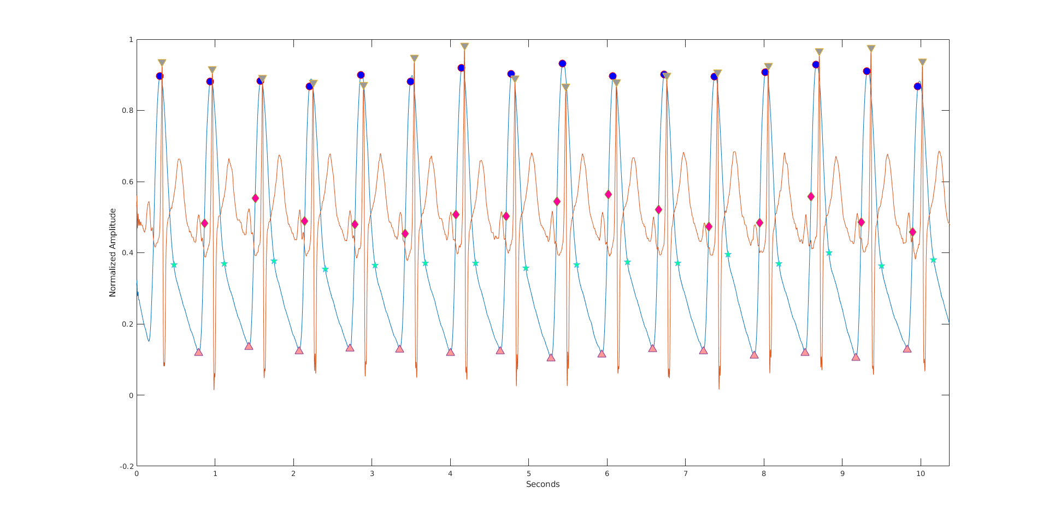
Feature Extraction: Parameter Based
Combined PPG-ECG plot with features identified
Circles: Systolic Peaks
Triangles: Diastolic Peaks
Diamonds: Max slope points
Stars: Inflection points

Slide 12
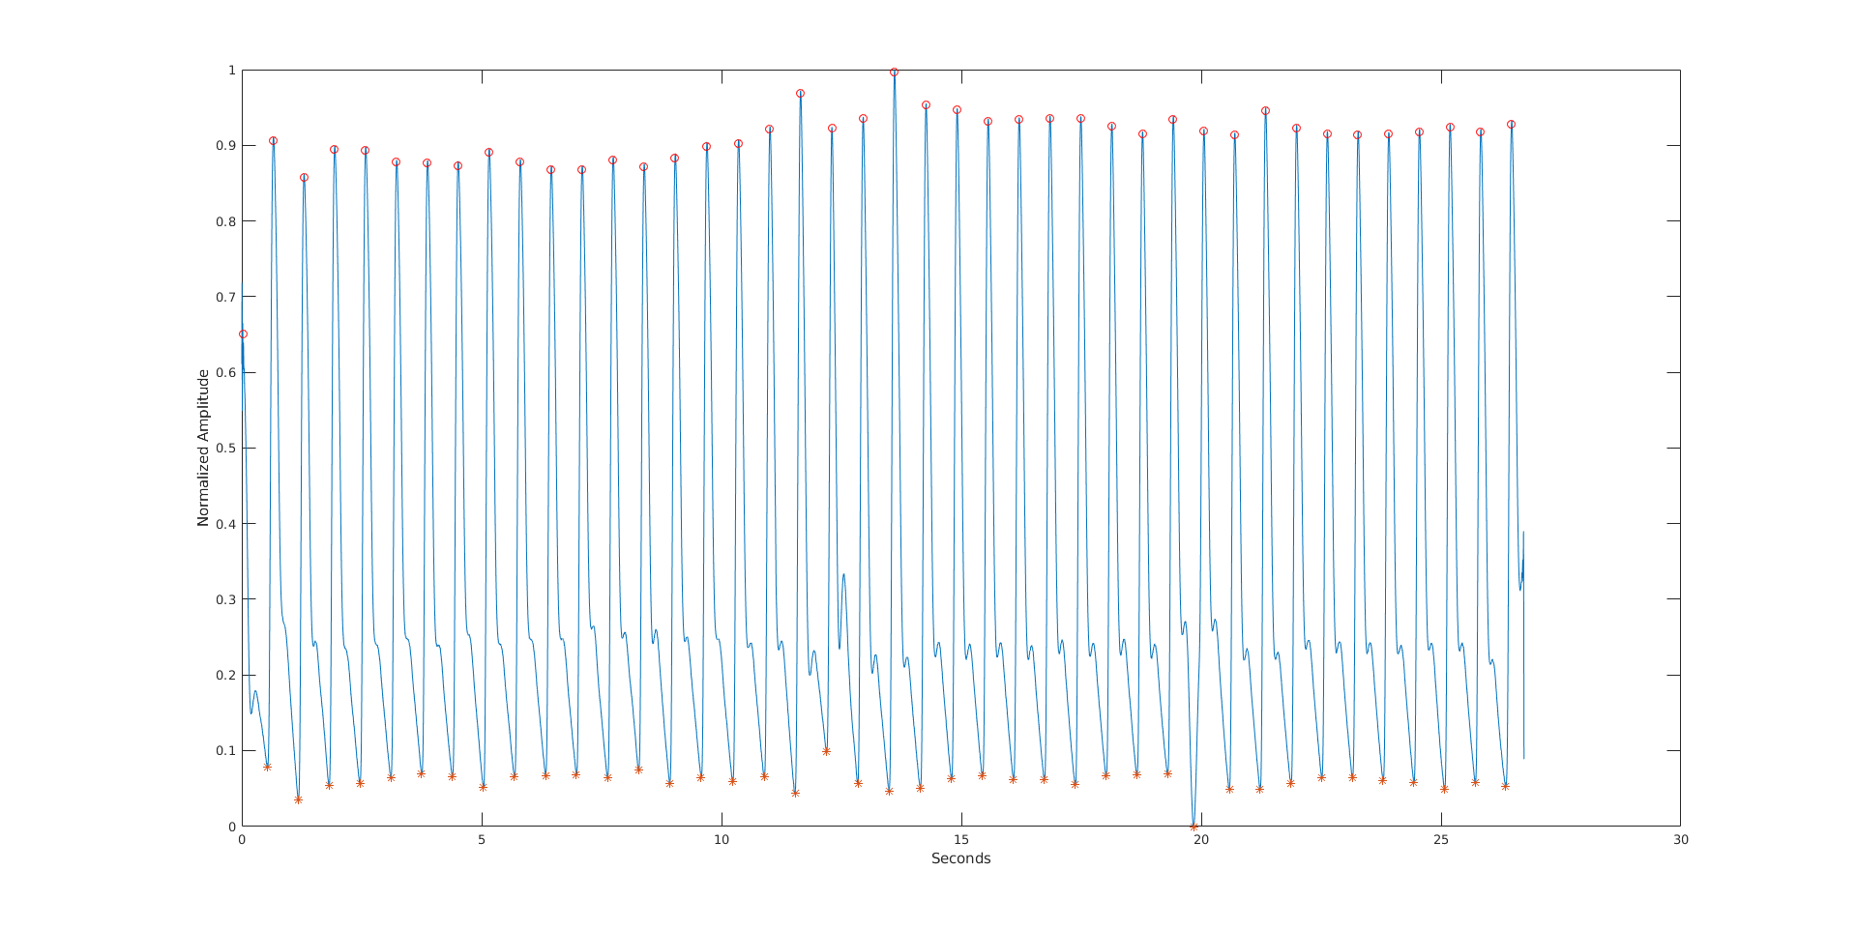
Feature Extraction: Parameter Based
ABP Signal with SBP and DBP identified
Circles: SBP*
Asterisk: DBP*
*Normalized

Slide 13
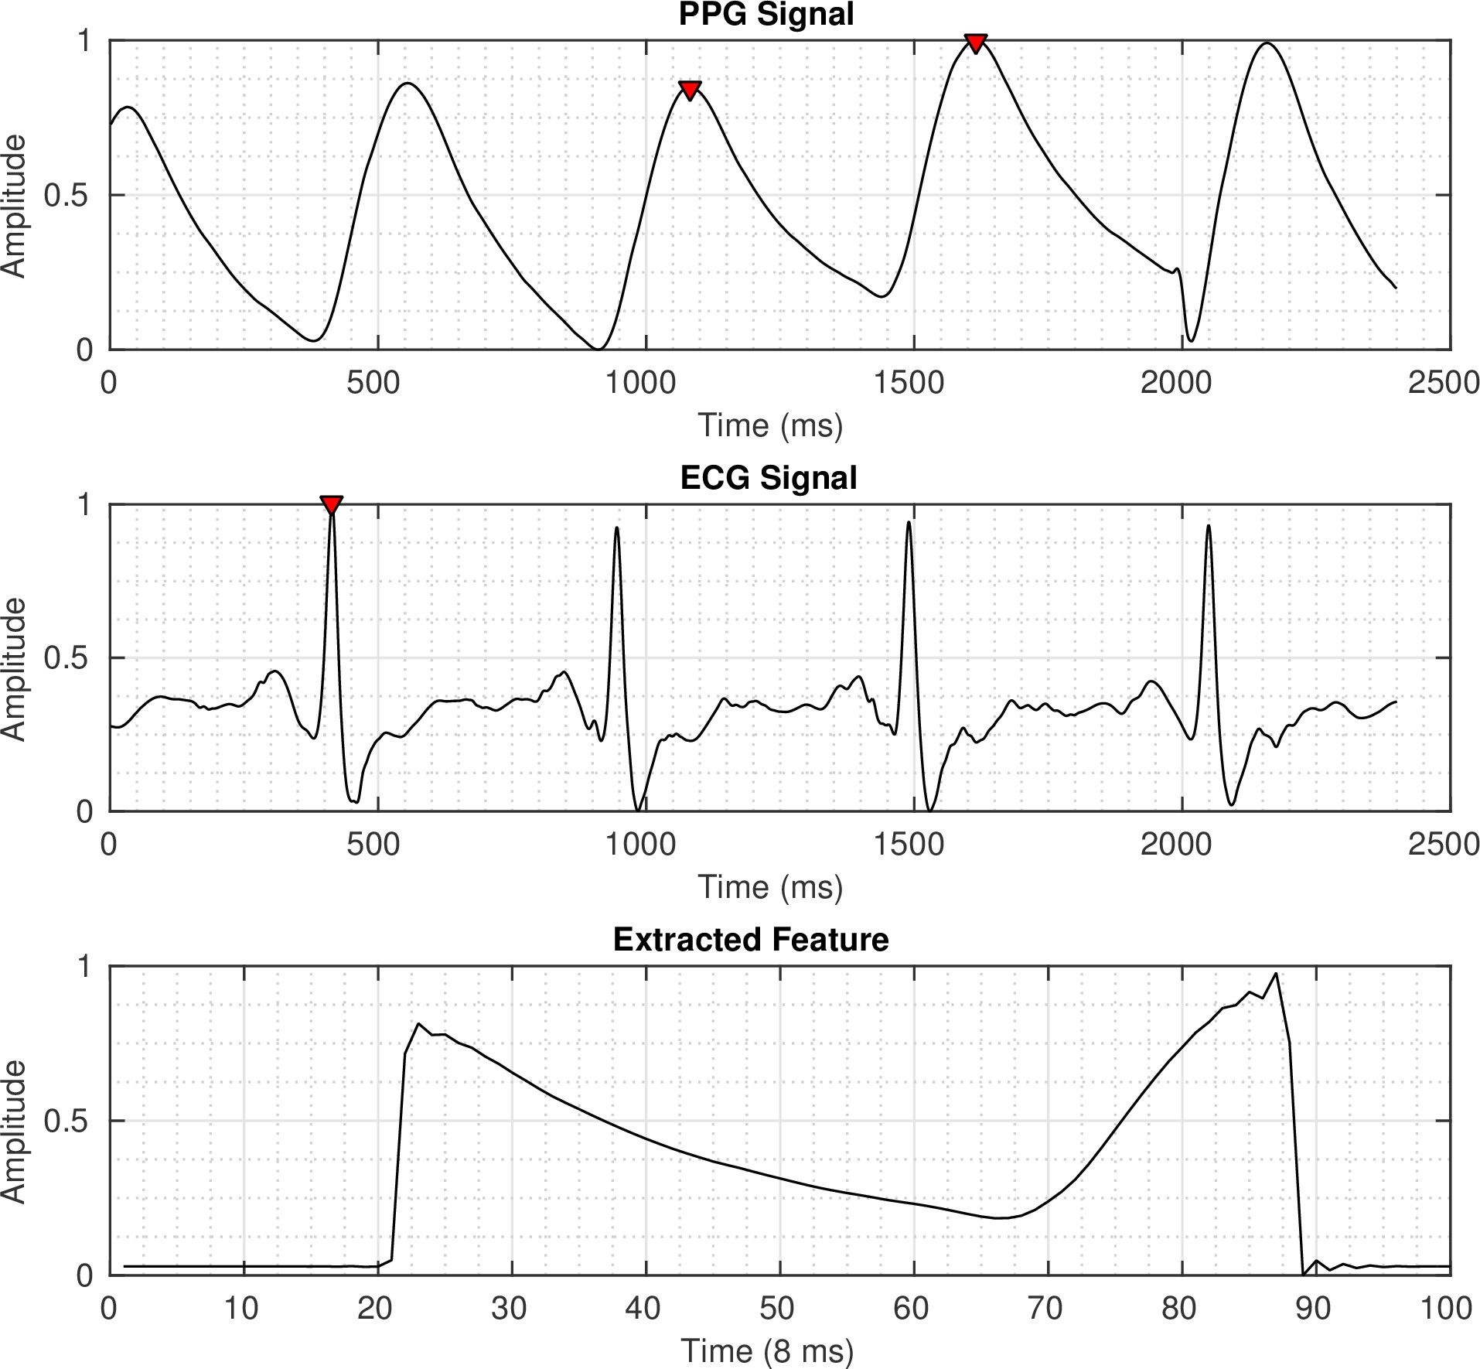
Feature Extraction: Whole Based
PPG waveform between two Systolic peaks.
Systolic peaks at distance greater than or equal to mean PATp from R-peak are selected.

Slide 14
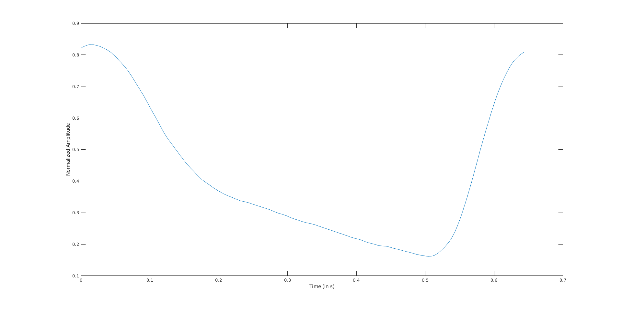
Feature Extraction: Whole Based
Whole Based Feature
Extracted using PPG signal

Slide 15
How We Split the Dataset
Training set: validation set: test set = 1: 1: 1
No cross validation, e.g. Kfold

Slide 16
Experiment setup
Matlab
Algorithms selection: we use the same ones in the paper
Linear Regression
Decision Tree(Regression Tree)
SVM
LSBoost
Random Forest

Slide 17
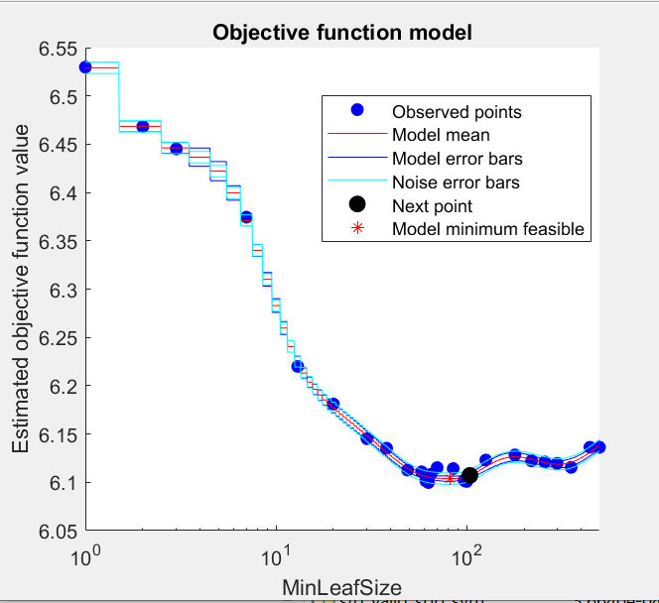
Hyper parameter tuning

Slide 18
Experiment result-validation
 | SBP |  |  |  | DBP
Feature | Parameter-based |  | Whole-based |  | Parameter-based |  | Whole-based
 | MAE | STD | MAE | STD | MAE | STD | MAE | STD
Linear Regression | 18.3384 | 14.0377 | 19.3276 | 12.5682 | 10.0460 | 9.5963 | 10.0925 | 8.2512
Decision Tree | 18.3937 | 13.1638 | 18.9243 | 13.0286 | 9.4340 | 8.0619 | 9.2437 | 7.8100
SVM | 19.0414 | 12.8246 | 19.0414 | 12.8246 | 9.2662 | 7.5963 | 9.2662 | 7.5943
LSBoost | 17.9582 | 12.1828 | 19.0535 | 12.5474 | 9.9250 | 8.4795 | 10.5231 | 8.0220
Random Forest | 17.8555 | 11.9739 | 19.0741 | 12.5277 | 9.7465 | 8.1683 | 10.8984 | 8.0036

Slide 19
Experiment result-test
 | SBP |  |  |  | DBP
Feature | Parameter-based |  | Whole-based |  | Parameter-based |  | Whole-based
 | MAE | STD | MAE | STD | MAE | STD | MAE | STD
Linear Regression | 21.8529 | 13.8757 | 22.7649 | 14.5258 | 9.2375 | 8.2620 | 9.6582 | 7.7014
Decision Tree | 24.5833 | 16.4895 | 25.3302 | 17.0232 | 8.6479 | 7.5251 | 8.9634 | 7.2748
SVM | 25.2589 | 16.8740 | 25.2589 | 16.8740 | 8.9241 | 7.2994 | 8.9241 | 7.2994
LSBoost | 19.5847 | 13.1805 | 22.5400 | 14.4620 | 9.2859 | 7.9595 | 9.5283 | 7.6226
Random Forest | 19.5951 | 13.0232 | 22.5165 | 14.5328 | 9.0530 | 7.5888 | 9.7610 | 7.5858

Slide 20
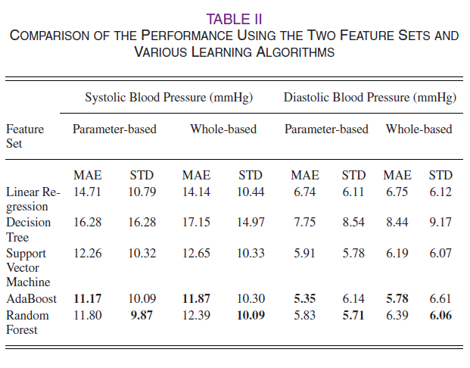
Paper result

Slide 21
Limitations
Some of the PPG, ECG and ABP signals are very noisy. Such noise could not be removed by conventional preprocessing.
The dataset we use for learning is relatively small compared to other Machine learning studies as well as the ones used in the paper.

Slide 22
Discussions
To improve the accuracy we can manually check the waveforms during training for large noise and remove them,
Also, we can add more data during learning phase from different individuals.
Calibration of extracted features can also improve accuracy.
It may be possible to extract more features from PPG and ECG signals for better estimation of SBP and DBP.

Slide 23
Conclusion
Our results indicate that cuffless blood pressure estimation using ECG and PPG signals is feasible within bounds of error.

Slide 24
Thank you!

